Slide 1

Adventure Works Sales Analysis Report For Sales Leadership
This report analyzes Adventure Works sales data, providing insights into revenue trends, product performance, and regional sales patterns.
Paul Lemaron
Turing College- DA

Slide 2
Problem Statement
1
What is the Overall Sales Overview over the years?
Understanding the different sources of revenue, and revenue generation over the
Years, the sales reasons of the products, and the salespersons’ revenue generation.
2
What are the product sales trends?
Revenue generation by product categories, and subcategories.
3
What is the sales trends per region?
Analysis of the revenue and profits generation by year, the sales sources distribution
By regions, Total products quantity per region

Slide 3
Sales Overview
Key Performance Indicators
Total Orders | Total Revenue | Profit | % Profit
31465 | $140,707, 584 | $9,371, 821 | 9.33%

Slide 4
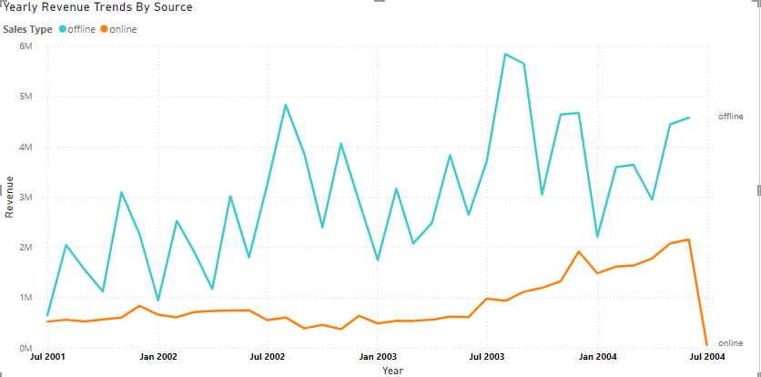
Sales Overview
Sales Channels & Revenue Generation
1
Offline Sales
Offline sells demonstrated an unsteady but progressive
Rise over the years while generating $5.8M at the highest
In July 2003.
2
Online Sales
Revenue decreased significantly between 2001 and 2004.
3
Revenue Trend
Online sales started trending upwards in July 2003.
Notes:
Overall Sales Trends:
Total revenue amounted to $140,707,584 with a profit of $9,371,821, representing a 9.33% profit margin.
Offline sales have shown a progressive increase, peaking at $5.8M in July 2003, while online sales experienced fluctuations, showing a significant upward trend from mid-2003 onwards.

Slide 5
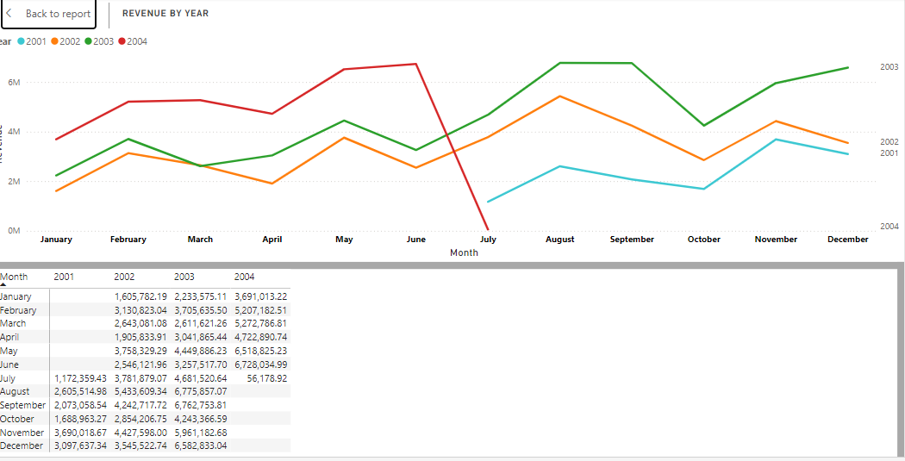
Sales Overview
Yearly Revenue
Highest Revenue
Revenue Distribution
FY2002 | FY2003 | FY2004 | Total Revenue
$29, 917, 523 | $43,585,635 | $67,148,244 | $140,707, 584
August 2003 contributed 4.82% of total revenue.
Best Sales Month always trends highest in August.
2004 had the highest
total revenue.
Notes:
Yearly Performance:
FY2004 generated the highest revenue at $67,148,244.
August consistently recorded the highest sales contribution across years, with August 2003 alone accounting for 4.82% of total revenue

Slide 6
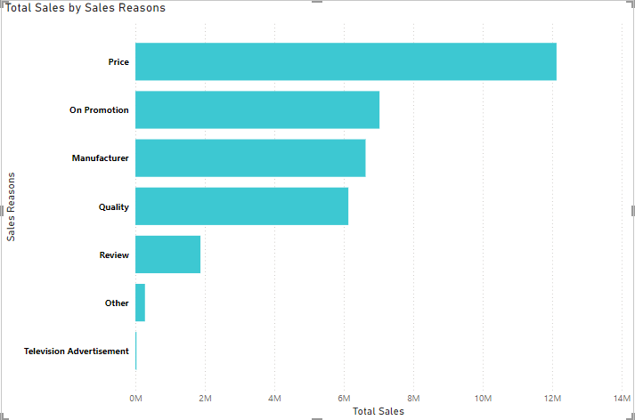
Sales Reasons Analysis
1
Highest Total Sales
Price had the highest total sales.
2
Sales Range
Total sales ranged from $ 30,360.81 to
$ 12,128,306.44.
3
Price Contribution
Price accounted for 35.57% of total sales.
Notes:
Top Sales Drivers:
Pricing emerged as the top factor, contributing 35.57% of sales revenue.
Sales ranged between $30,360.81 and $12,128,306.44, showing significant disparities in product performance.

Slide 7
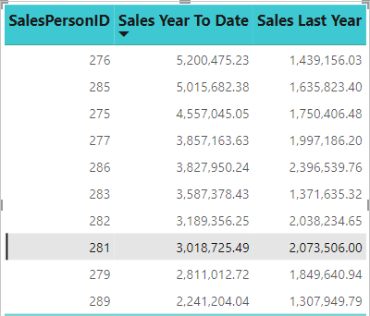
Top 10 Sales Persons Analysis
1
Highest Salespersons
$5,200,475 by salesperson with ID 276 had the
highest sales.
Notes:
Top Performers:
Salesperson ID 275 achieved the highest sales, generating $5,200,475, highlighting disparities in individual performance

Slide 8
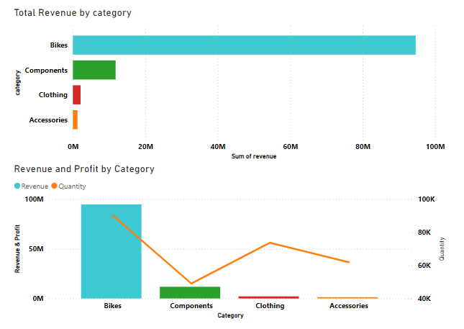
Product Performance
Category
Revenue
Quantity
Bikes
$94,651,172.71
90,268
Components
$11,802, 593
49,044
Clothing
$ 2,120,542
73,670
Accessories
$ 1,272,072.89
61,932
Notes:
Product Performance:
Bikes dominated revenue generation ($94.65M), with road bikes leading at over $40M.
Accessories like helmets and tires performed best within their category, contributing 42% and 21% of accessory revenue, respectively.
Top-selling product: "Mountain-200 Black, 38" at 7.19% of total bike sales

Slide 9
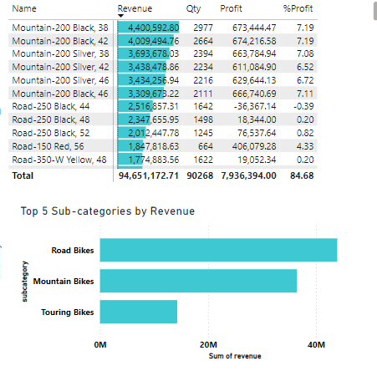


Product Performance
Bikes Subcategories Sales
Top Sales Products
Mountain-200 Black, 38 makes the highest sales at
7.19% and $4.4M in the bikes categories
Bikes Best Sales
The road bikes generated over $40M in revenue
With the mountain bikes coming in second with
Over $30M in revenue generation.

Slide 10
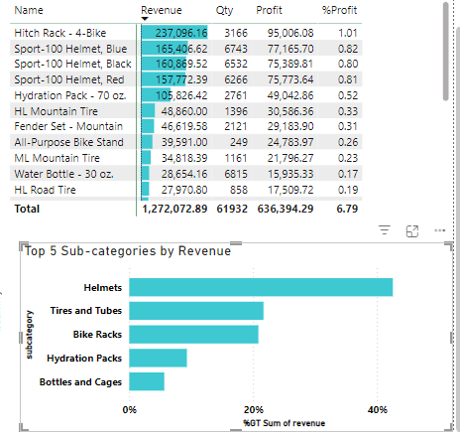
Product Performance
Accessories Subcategories Sales
Top Sales Products
The Hitch Rack-4 Bike generated $237,097 and a profit
Of 1.01% as the best selling accessory.
Accessories subcategory Best Sales
Helmets and tires and tubes were the best selling
Accessories at 42% and 21% of total revenue generation
By the accessories.

Slide 11
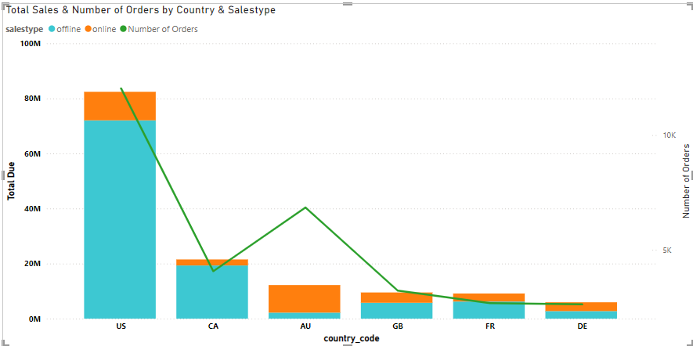

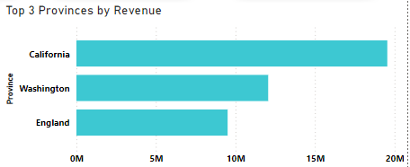

Regional Sales Analysis
Total Due
Offline sales had higher total due than online.
USA Contribution
USA offline sales contributed 51.21% of total due.
Average Total Due
Offline sales had higher average total due than online.
Top 3 Provinces
California had the highest revenue, followed by
Washington and England.
Notes:
Regional Sales Analysis:
Offline sales contributed 51.21% of total dues, with the USA leading geographically.
Top provinces by revenue: California, Washington, and England.
Offline channels exhibited higher average total dues compared to online.

Slide 12
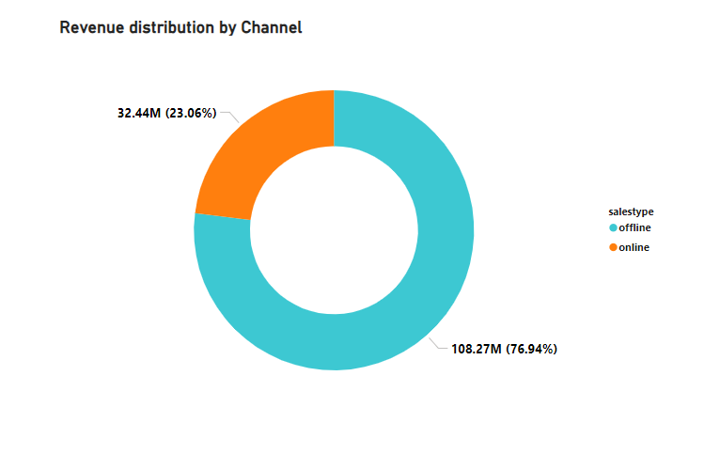


Sales Channel Analysis
Offline Sales
Online Sales
Offline sales had a significant impact on total revenue.
Online sales contributed to a smaller portion of total revenue but continues to show a steady rise over the years.

Slide 13
Recommendations
Sales Channel Optimization:
Invest in expanding online sales capabilities, as they show a rising trend and potential for growth, especially post-2003 with a sharp rise from $484,946 to an all-time high of $2.1M sales.
Product Strategy:
Focus on high-revenue categories like bikes, particularly road and mountain subcategories, by refining inventory strategies and marketing efforts.
Promote high-performing accessories (e.g., helmets, tires) by bundling them with bike purchases to increase cross-selling opportunities.
Regional Strategy:
Increase market penetration in top-performing regions like California and Washington while exploring opportunities in underperforming areas.
Team Performance:
Identify and replicate the strategies of top-performing salespersons, such as ID 276 who generated $5.1M, across the team to enhance overall sales productivity.

